Slide 1
Part Two: Encryption Principles
Chapter 2.3
RSA

Slide 2



Internet

Slide 3
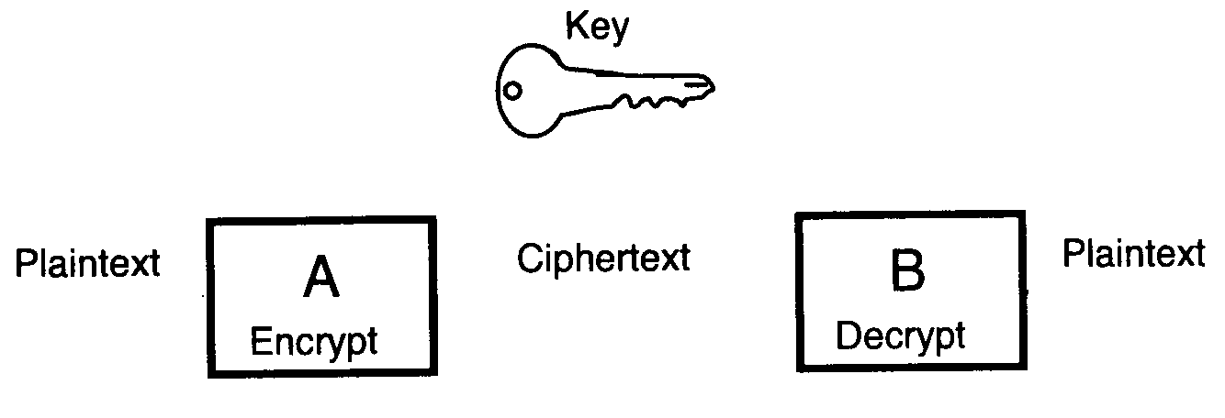
Conventional Encryption

Slide 4

Introduction of Public Key Idea
New Directions in Cryptography
W. Diffie and M. Hellman
IEEE Trans. Inform. Theory
vol. IT-22, no. 6, pp. 644-654, 1976.
https://www.youtube.com/watch?v=ROCray7RTqM

Slide 5
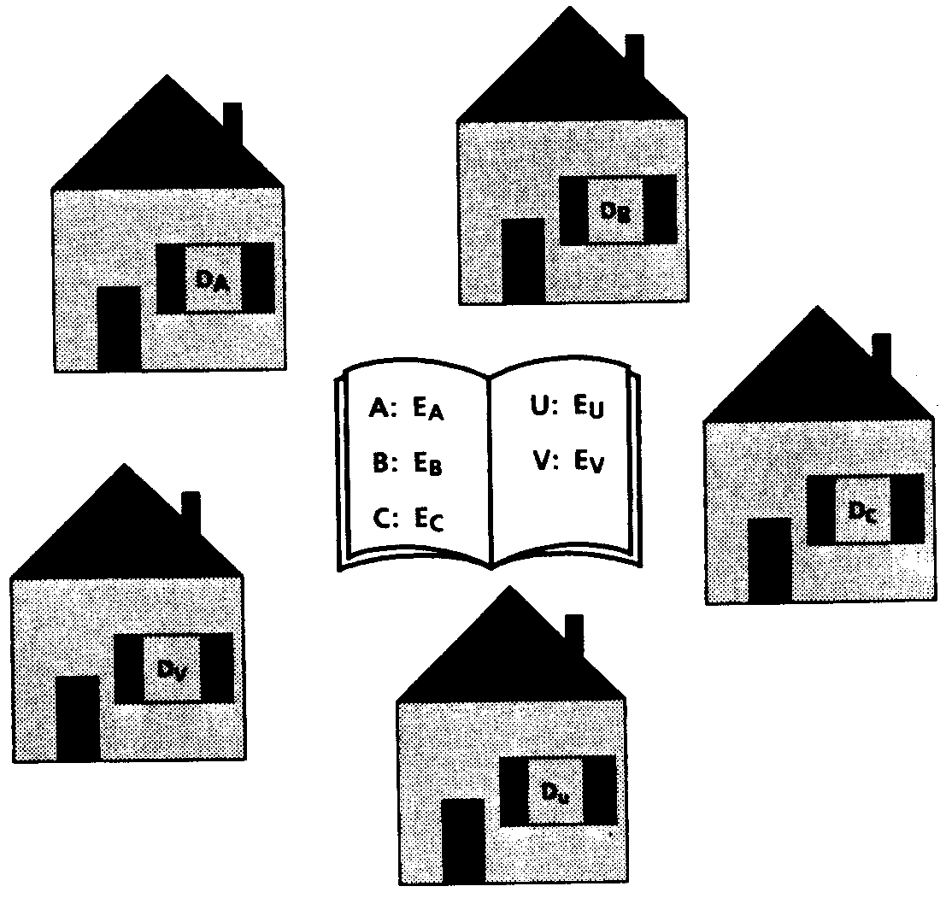
Public Key Cryptosystem
private key
private key
public keys
private key
private key
private key

Slide 6
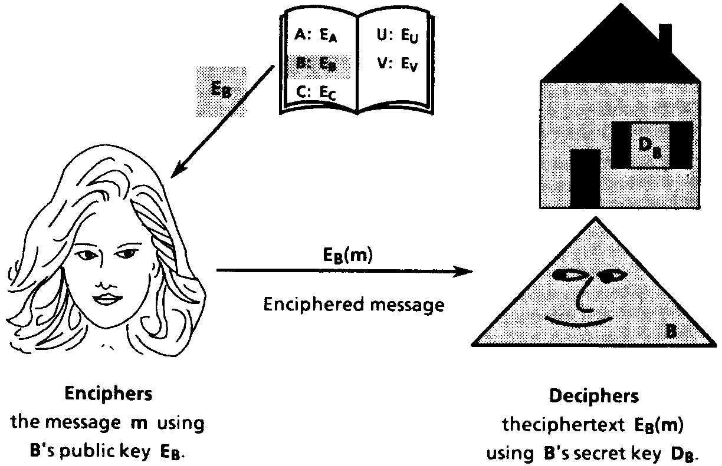
Public Key Encryption Scheme

Slide 7
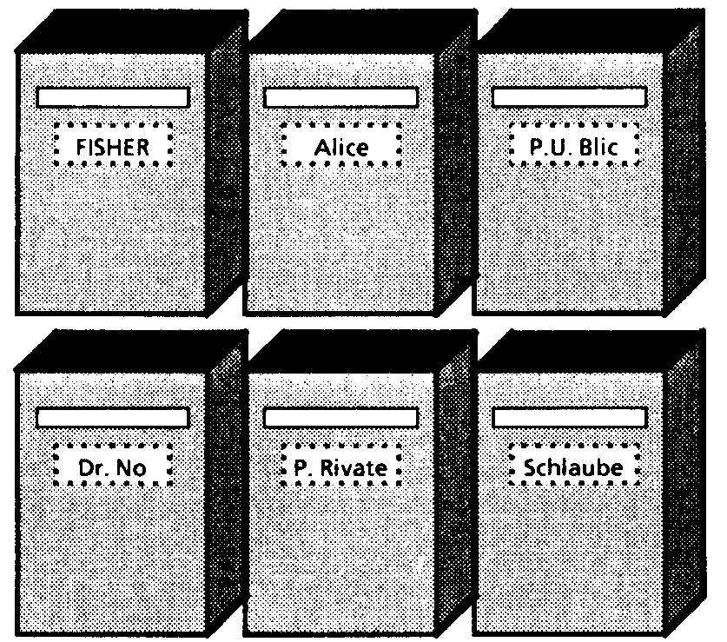
Mailboxes

Slide 8
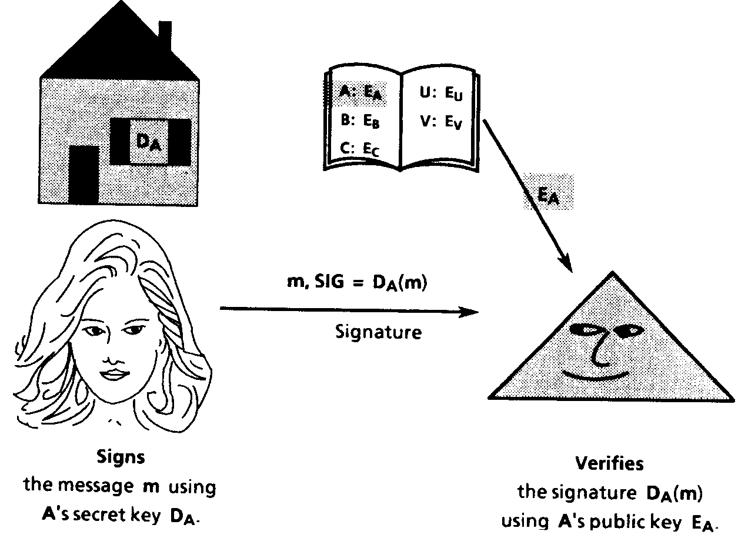
Digital Signature Scheme

Slide 9
Handwriting Signature
Suppose that a doctor has signed a prescription. Then, ideally, his signature has the following characteristics:
Only signer may produce this signature.
Anyone may verify that this signature is his.

Slide 10

RSA Public Key Cryptosystem
A Method for Obtaining Digital Signatures and Public-Key Cryptosystems
R. L. Rivest, A. Shamir and L. Adleman
Communications of ACM
vol. 21 , no. 2, pp. 120-126, 1978
https://www.youtube.com/watch?v=b57zGAkNKIc

Slide 11
RSA
Key generation
Encryption
Decryption
Digital signature generation
Digital signature verification

Slide 12
RSA: Key Generation
Choose two distinct prime numbers p and q randomly.
Compute the product n= p·q and Φ(n)=(p-1)(q-1). https://www.youtube.com/watch?v=n4j0iS6A2Rc
Choose an integer e randomly such that 0<e<Φ(n) and gcd (e, Φ(n))=1.
Compute d such that 0<d<Φ(n) and e·d=1 (mod Φ(n)).
Publish (n, e), keep (p, q, d) secret.
Note: e – public key (or encryption key) d - private key (or decryption key)

Slide 13
RSA: Encryption
M={m,…}
l bits
l bits
l bits
l bits
l bits
e
RSA
RSA
RSA
RSA
RSA
l bits
l bits
l bits
l bits
l bits
Looking up (n,e)
C={c,…}
l is the greatest integer such that 2^{l} <n m< 2^{l} <n Encryption: c=E(m, e)=m^{e} (mod n)

Slide 14
RSA: Decryption
C={c,…}
l bits
l bits
l bits
l bits
l bits
d
RSA
RSA
RSA
RSA
RSA
l bits
l bits
l bits
l bits
l bits
M={m,…}
Decryption:
D(c, d)=c^{d} =m (mod n)

Slide 15
RSA: Signing
M={m,…}
l bits
l bits
l bits
l bits
l bits
d
RSA
RSA
RSA
RSA
RSA
l bits
l bits
l bits
l bits
l bits
S={s,…}
Signing: s=D(m, d)=m^{d} (mod n)

Slide 16
RSA: Verifying
S={s,…}
l bits
l bits
l bits
l bits
l bits
e
RSA
RSA
RSA
RSA
RSA
l bits
l bits
l bits
l bits
l bits
M={m,…}
Looking up (n,e)
Verifying: E(s, e)=s^{e} =m (mod n)

Slide 17
Question
1. How to determine whether gcd (e, Φ(n))=1?
2. How to compute d such that e·d=1 (mod Φ(n))?
3. D(E(m,e),d)=m? E(D(m,d),e)=m?
4. How to compute x^{e}(mod n) or x^{d} (mod n) efficiently?

Slide 18
Example
p=37, q=23, n=p*q=851
Φ(n)=(p-1)*(q-1)=(37-1)*(23-1)=792
Case 1: 1<e=75<792
gcd(75,792)=3
75 cannot be used as a public key
Case 2: 1<e=35<792
gcd(35,792)=1
35 can be used as a public key

Slide 19
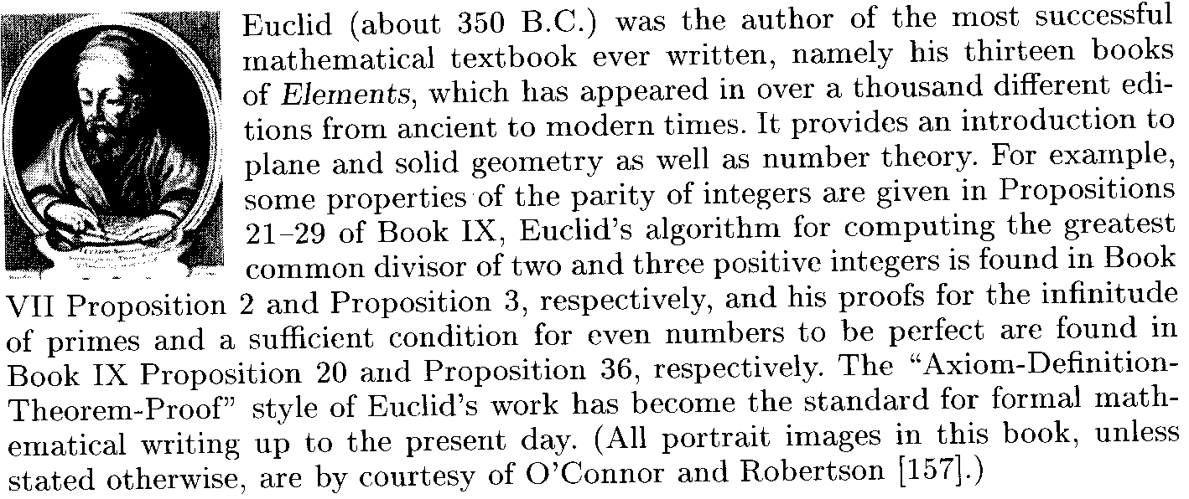
Euclidean Algorithm
Theorem: gcd (a, b)=gcd (b, a (mod b))
gcd(792,75)=(75, 792 (mod 75))=(75,42)
=(42,75 (mod 42))=(42, 33)
=(33,42(mod 33))=(33, 9)
=(9, 33 (mod 9))=(9,6)=(6,3)=(3,0)=3

Slide 20
Cont.
Find gcd (792, 35).
gcd(792,35) 792=22*35+22 gcd(35,22) 35=1*22+13 gcd(22,13) 22=1*13+9 gcd(13,9) 13=1*9+4 gcd(9,4) 9=2*4+1 gcd(4,1) 4=4*1+0 gcd(1,0)=1
gcd (792, 35)=1 https://www.youtube.com/watch?v=p5gn2hj51hs
Note: gcd(n,0)=n for any integer n because 0=0*n.

Slide 21
How to Choose Public Key e
Step 1: Choose an integer e such that 0<e<Φ(n) randomly.
Step 2: Calculate gcd (e, Φ(n)) using Euclidean Algorithm.
Step 3: If gcd (e, Φ(n))=1, stop. Otherwise, go to Step 1.

Slide 22
Extended Euclidean Algorithm
For any two integers a and b, there are two integers x and y such that
a • x + b • y = gcd (a, b)

Slide 23
Iterative Method
Find x and y such that 792*x+35*y=gcd(792,35)
792=22*35+22 1=9-2*4=9-2*(13-9)=3*9-2*13
35=22+13 =3*(22-13)-2*13=3*22-5*13
22=13+9 = 3*22-5*(35-22)=8*22-5*35
13=9+4 =8*(792-22*35)-5*35
9=2*4+1 =8*792 -181*35
792*8+35*(-181)=1 https://www.youtube.com/watch?v=fz1vxq5ts5I
35*(-181)=1 (mod 792)
d= -181=792-181=611 (mod 792)

Slide 24
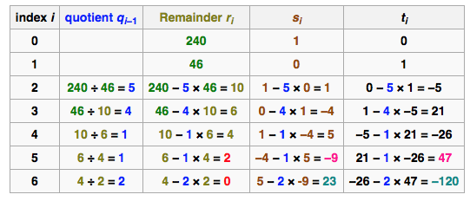
Table Method (Magic Box)
240*x+46*y = gcd (240, 46)
240 *(-9) + 46*47 = 2
Notes:
For example, to solve m x + n y = gcd(m,n) one begins with
two rows [m 1 0], [n 0 1], representing the two
equations m = 1m + 0n, n = 0m + 1n. Then one executes
the Euclidean algorithm on the numbers in the first column,
doing the same operations in parallel on the other columns,
Here is an example: d = x(80) + y(62) proceeds as:
in equation form | in row form
---------------------+------------
80 = 1(80) + 0(62) | 80 1 0
62 = 0(80) + 1(62) | 62 0 1
row1 - row2 -> 18 = 1(80) - 1(62) | 18 1 -1
row2 - 3 row3 -> 8 = -3(80) + 4(62) | 8 -3 4
row3 - 2 row4 -> 2 = 7(80) - 9(62) | 2 7 -9
row4 - 4 row5 -> 0 = -31(80) -40(62) | 0 -31 40
Above the row operations are those resulting from applying
the Euclidean algorithm to the numbers in the first column,
row1 row2 row3 row4 row5
namely: 80, 62, 18, 8, 2 = Euclidean remainder sequence
| |
for example 62-3(18) = 8, the 2nd step in Euclidean algorithm
becomes: row2 -3 row3 = row4 on the identity-augmented matrix.
In effect we have row-reduced the first two rows to the last two.
The matrix effecting the reduction is in the bottom right corner.
It starts as the identity, and is multiplied by each elementary
row operation matrix, hence it accumulates the product of all
the row operations, namely:
[ 7 -9] [ 80 1 0] = [2 7 -9]
[-31 40] [ 62 0 1] [0 -31 40]
row 1 is the particular solution 2 = 7(80) - 9(62)
row 2 is the homogeneous solution 0 = -31(80) + 40(62),
so the general solution is any linear combination of the two:
n row1 + m row2 -> 2n = (7n-31m) 80 + (40m-9n) 62
The same row/column reduction techniques tackle arbitrary
systems of linear Diophantine equations. Such techniques
generalize easily to similar coefficient rings possessing a
Euclidean algorithm, e.g. polynomial rings F[x] over a field,
Gaussian integers Z[i]. There are many analogous interesting
methods, e.g. search on keywords: Hermite / Smith normal form,
invariant factors, lattice basis reduction, continued fractions,
Farey fractions / mediants, Stern-Brocot tree / diatomic sequence.

Slide 25
Cont.
120*x+23*y = gcd (120,23)
120 *(-9) + 23*47 = 1
x | y | d | k
1 | 0 | 120
0 | 1 | 23 | 5
1 | -5 | 5 | 4
-4 | 21 | 3 | 1
5 | -26 | 2 | 1
-9 | 47 | 1 | 2
Notes:
For example, to solve m x + n y = gcd(m,n) one begins with
two rows [m 1 0], [n 0 1], representing the two
equations m = 1m + 0n, n = 0m + 1n. Then one executes
the Euclidean algorithm on the numbers in the first column,
doing the same operations in parallel on the other columns,
Here is an example: d = x(80) + y(62) proceeds as:
in equation form | in row form
---------------------+------------
80 = 1(80) + 0(62) | 80 1 0
62 = 0(80) + 1(62) | 62 0 1
row1 - row2 -> 18 = 1(80) - 1(62) | 18 1 -1
row2 - 3 row3 -> 8 = -3(80) + 4(62) | 8 -3 4
row3 - 2 row4 -> 2 = 7(80) - 9(62) | 2 7 -9
row4 - 4 row5 -> 0 = -31(80) -40(62) | 0 -31 40
Above the row operations are those resulting from applying
the Euclidean algorithm to the numbers in the first column,
row1 row2 row3 row4 row5
namely: 80, 62, 18, 8, 2 = Euclidean remainder sequence
| |
for example 62-3(18) = 8, the 2nd step in Euclidean algorithm
becomes: row2 -3 row3 = row4 on the identity-augmented matrix.
In effect we have row-reduced the first two rows to the last two.
The matrix effecting the reduction is in the bottom right corner.
It starts as the identity, and is multiplied by each elementary
row operation matrix, hence it accumulates the product of all
the row operations, namely:
[ 7 -9] [ 80 1 0] = [2 7 -9]
[-31 40] [ 62 0 1] [0 -31 40]
row 1 is the particular solution 2 = 7(80) - 9(62)
row 2 is the homogeneous solution 0 = -31(80) + 40(62),
so the general solution is any linear combination of the two:
n row1 + m row2 -> 2n = (7n-31m) 80 + (40m-9n) 62
The same row/column reduction techniques tackle arbitrary
systems of linear Diophantine equations. Such techniques
generalize easily to similar coefficient rings possessing a
Euclidean algorithm, e.g. polynomial rings F[x] over a field,
Gaussian integers Z[i]. There are many analogous interesting
methods, e.g. search on keywords: Hermite / Smith normal form,
invariant factors, lattice basis reduction, continued fractions,
Farey fractions / mediants, Stern-Brocot tree / diatomic sequence.

Slide 26
How to Compute Private Key d
gcd (e, Φ(n))=1
→Φ(n) • x +e • y =1 (extended Euclidean …)
→e • y = 1 (mod Φ(n))
→d = y
Note: d is the multiplicative inverse of e modular Φ(n).

Slide 27
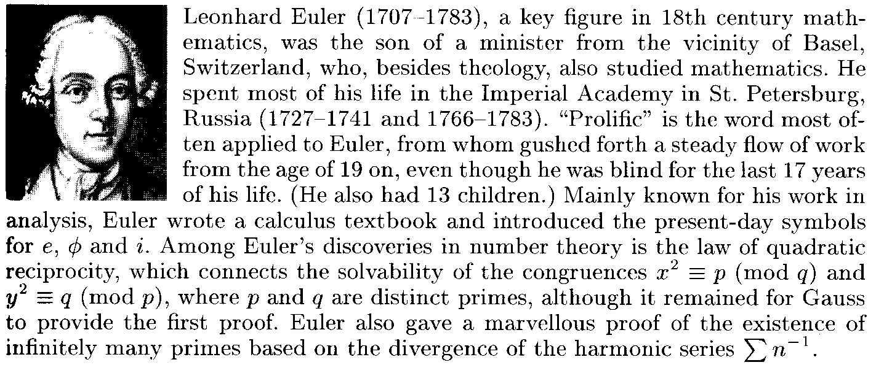
Extended Euler’s Theorem
If p and q are two distinct primes, n=p*q, then for all m∈{0,1,…,n-1}
m^{Φ(n)+1}=m (mod n)
where Φ(n)=(p-1)*(q-1).

Slide 28
RSA: D(E(m,e),d)=m
D(c, d)=c^{d}
=(m^{e})^{d} (c=E(m, e)=m^{e} (mod n) - encrypt)
=m^{ed}
=m^{Φ(n)•k+1} (e*d=1 (mod Φ(n)) – key generation)
=m^{Φ(n)•k}•m= m^{Φ(n)•(k-1)}•m^{Φ(n)+1}
=m^{Φ(n)•(k-1)}•m (m^{Φ(n)+1}=m (mod n) - Euler’s Theorem)
=m (mod n)

Slide 29
RSA: E(D(m,d),e)=m
E(s, e)=s^{e}
=(m^{d})^{e} (s=D(m, d)=m^{d} (mod n) - decryption)
=m^{de} =m^{ed}
=m^{Φ(n)•k+1} (e*d=1 (mod Φ(n)) – key generation)
=m^{Φ(n)•k}•m= m^{Φ(n)•(k-1)}•m^{Φ(n)+1}
=m^{Φ(n)•(k-1)}•m (m^{Φ(n)+1}=m (mod n) - Euler’s Theorem)
=m (mod n)

Slide 30
RSA (example)
1. p=3,q=17
n=3•17=51, Φ(n)=(3-1)(17-1)=32
e=7, e*d=1 (mod 32), d=23
7•23=161=1 (mod 32)
4. m=2
Encryption: c= m^{e} = 2⁷=26(mod 51) Decryption: m= c^{d} = 26²³= 2(mod 51) Signing: s= m^{d} = 2²³=26(mod 51) Verifying: m= s^{e}= 26⁷= 2(mod 51)

Slide 31
Cont.
Computation of x^{e} (mod n)
https://www.youtube.com/watch?v=sL-YtCqDS90
RSA (another example)
https://www.youtube.com/watch?v=_IwMX1zwcUE

Slide 32
Fast Exponentiation
Consider computing c = m^{e} (mod n) where e = e_{r}·2^{r} + e_{r-1}·2^{r-1}+…+ e₁·2¹+ e₀ and e_{i}=0 or 1 (i.e., e=(e_{r}e_{r-1}…e₁e₀))
m², m⁴=(m²)², m⁸=(m⁴)² , …….
For example,
26²³ = 26⁽¹⁰¹¹¹⁾= 26¹⁶⁺⁴⁺²⁺¹
= ((((26²) ²) ²) ²) ·(26²)² ·26²·26 (mod 51)
26²=13, (26²)² =13²=16, (((26²) ²) ²)=16²=1
26²³=1·16 ·13·26=5408=2 (mod 51)

Slide 33
Security of RSA
1. Difficulty in factorizing the large modulus n
User: p,q→n=p•q → Φ(n)=(p-1)(q-1)
e→e*d=1 (mod Φ(n))→d
Adversary: n→hard→p,q
n→hard→Φ(n), e→hard→d
Note: For n with 200-digit, factorization of n will take over 100 years. The best record in the integer factorization is: thousands of networked computers factorized 155-digit n successfully.

Slide 34
Cont.
2. Difficulty in solving discrete logarithm problem
Adversary: c=E(m, e)=m^{e} (mod n)
(m, c), m=c^{d} (mod n) →hard→d
n with 200-bit, 2.7 • 10¹¹ steps
n with 664-bit, 1.2 • 10²³ steps
Note: Discrete logarithm problem is even harder than integer factorization problem.

Slide 35
RSA Security
In RSA, a ciphertext sent from Alice to Bob is C=10. Bob’s public key is e=5, n=35. What is the plaintext M?
35=5*7, ∅(n)=(5-1)(7-1)=24
ed=5d=1(mod 24) → d=5
M=C⁵ = 10⁵= 5 (mod 35)
(Verifying: C=M⁵ = 5⁵= 10 (mod 35) )

Slide 36
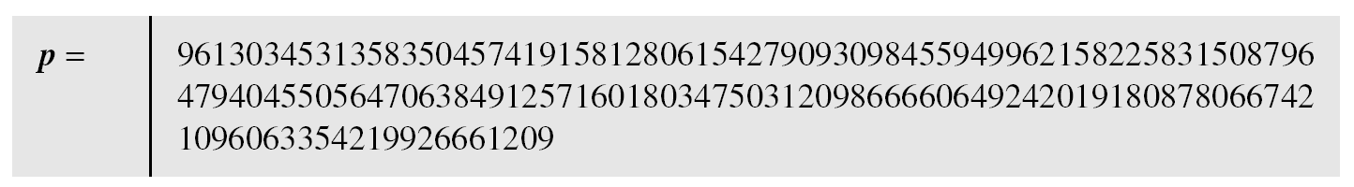
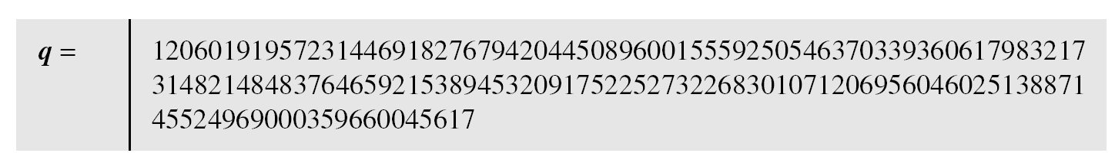
RSA Example
We choose a 512-bit p and q, calculate n and φ(n), then choose e and test for relative primeness with φ(n). The integer p is a 159-digit number.

Slide 37
Cont.
The modulus n = p × q. It has 309 digits.
φ(n) = (p − 1)(q − 1) has 309 digits.

Slide 38
Cont.
Bob chooses e = 35535 and tests it to make sure it is relatively prime with φ(n). He then finds the inverse of e modulo φ(n), i.e., d.

Slide 39
Cont.
Alice wants to send the message “THIS IS A TEST”, which can be changed to a numeric value using the 00−26 encoding scheme (26 is the space character).
The ciphertext calculated by Alice is c = m^{e}(mod n) which is

Slide 40
Problem with Small Message
Consider a small message m <T, its ciphertext is
c=m^{e} (mod n),
give (e, n) and c
exhaustive searching m<T such that
c=m^{e} (mod n)
solution: c=(m|r)^{e} (mod n) where r is a random number.

